Slide 1
U1 M3 L3 SIMPLE CIRCUITS

Slide 2
How do electric particles flow?
Electric current flows in a closed path to and from a source of electric energy. This is called an electric circuit.
Simple Circuits
All simple circuits contain a source of electric energy, an electric device, and an electric conductor.
In simple circuit made up of a battery and a light bulb, the battery is the electric energy source. The electric device is the light bulb.
The wires connecting the battery to the light bulb are the electric conductors. A switch is often included in a circuit.

Slide 3
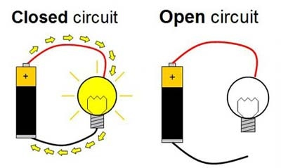
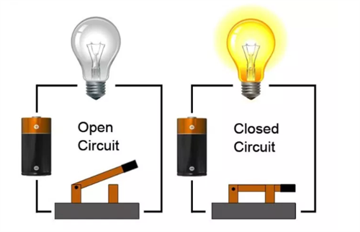
CLOSED VS. OPEN CIRCUITS
When a circuit is complete and energy flows through the circuit, it is called closed circuit. An open circuit is not a complete circuit. Electric energy does not flow through an open circuit. A switch is used to change a circuit between open and closed.

Slide 4
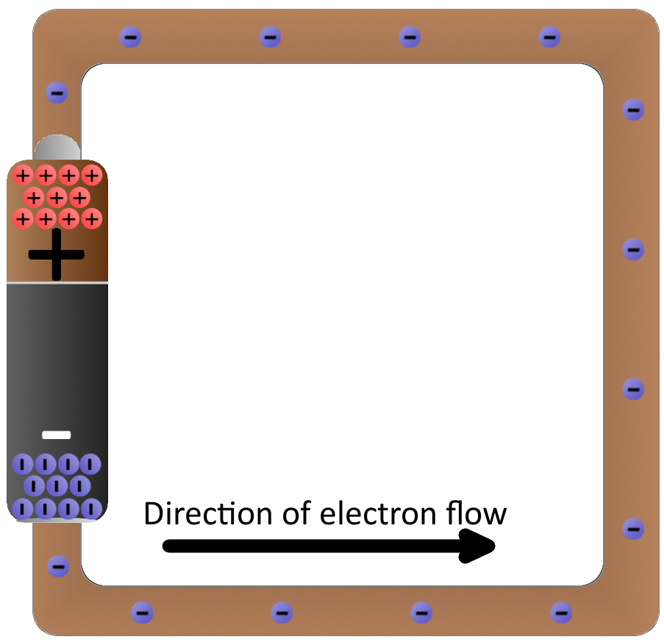
Charged Particles
The movement of electrically charged particles is called an electric current.
Batteries are often the source of electric energy for an electric circuit.
When a closed circuit connects the battery’s terminals, the charges travel along the conducting wire by the repulsive force between the like charged particles that the attractions between unlike charges.

Slide 5
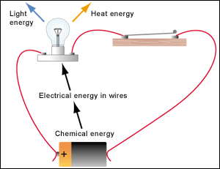
Charged Particles
If the circuit is closed, and the chemicals in the battery continue reacting, an electric current continues. When the electrical charges pass through the electric device, electric energy is transferred to the device

Slide 6
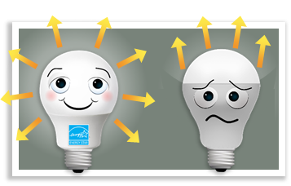
What factors affect an electric current?
A light bulb is a device that converts electrical energy into light.
The more energy, or current, the more light is produced.
factors affect the amount of current that flows through the conductive material?
Voltage In the figure below, a battery creates an electric current in a closed circuit. the amount of energy transferred by the circuit depends on the battery’s voltage (V).
Voltage is the electrical potential energy
difference between two places on a circuit.

Slide 7
The measure of the potential energy
The measure of the potential energy difference is made in volts (V)
. A circuit with a high voltage source transfers more electric energy to other energy forms than a circuit with a low voltage source.
For example, a light bulb connected to a 6-V battery produces about two times the light and thermal energy than the same light bulb connected to a 3-V battery
https://phet.colorado.edu/en/simulations/circuit-construction-kit-dc

Slide 9
Energy
In a circuit, electric energy is transferred to electrical devices. For example, when electric energy is transferred to a light bulb, the electric energy becomes light and thermal energy. Even the wires and batteries produce a small amount of thermal energy.
In other words, different amounts of energy are transferred in different parts of a circuit. The voltage measured across a portion of a circuit indicates how much energy is transferred in that portion of the circuit.

